Slide 1
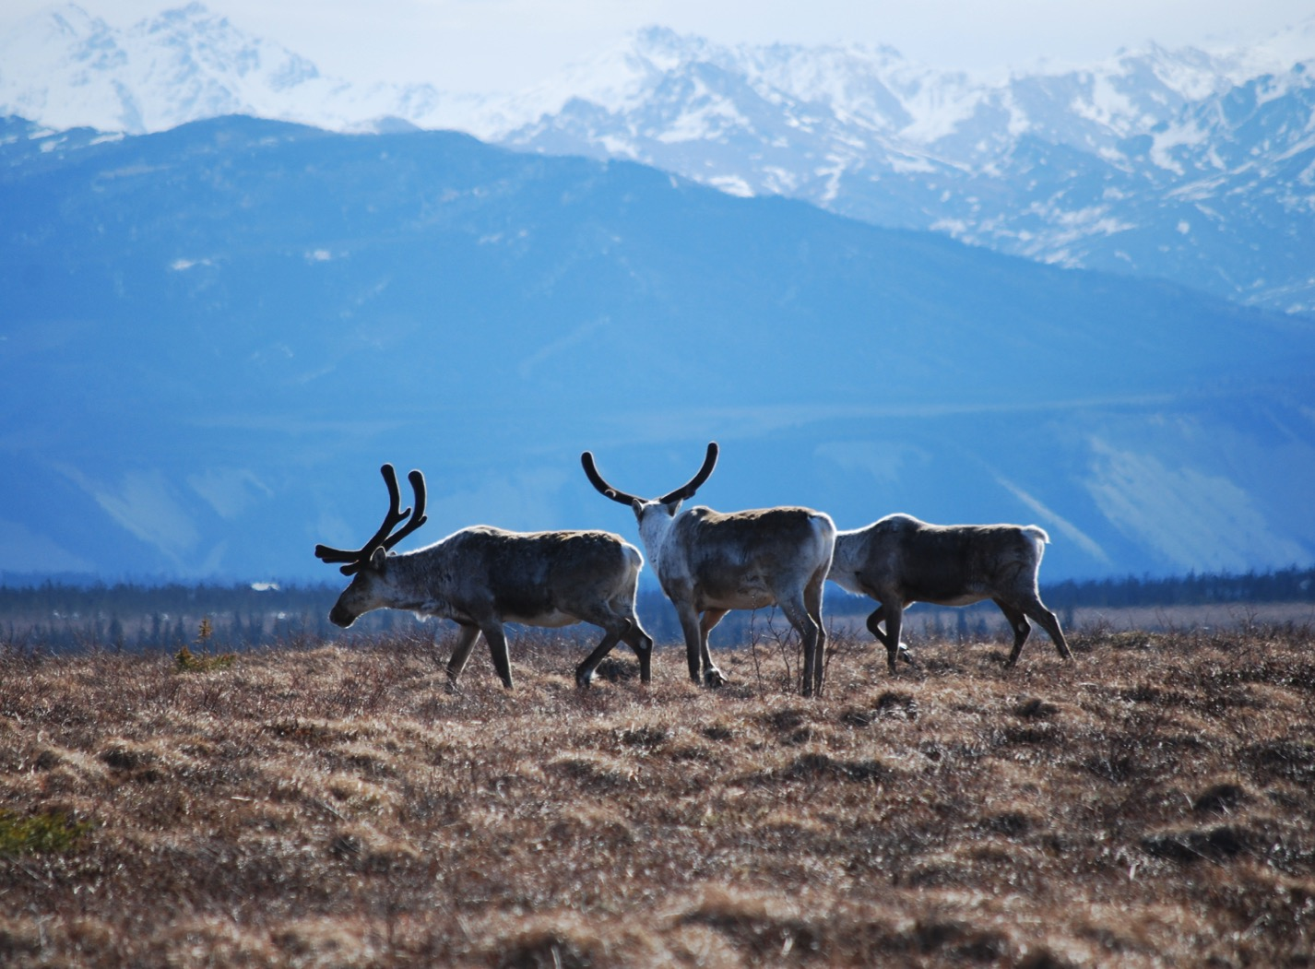
Arctic Boreal Vulnerability Experiment (ABoVE)
2017 ABoVE Airborne Campaign
14 August 2017 (DOY 226)
P-band SAR Campaign #2:
SW Alaska – Yukon-Kuskokwim Delta
Charles Miller, Deputy Science Lead
Jet Propulsion Laboratory, California Institute of Technology
and the ABoVE Science Team For Hank Margolis, Eric Kasichke, Bruce Tagg
NASA HQ
August 2017

Slide 2
14 August 2017/DOY 226 SW Alaska – Yukon-Kuskokwim Delta
P-band SAR / JSC G-III (N992NA)
Location: Fairbanks AK (PAFA)
Pilots: Chris Condon (Trigger)
Tom Ryan (T-Rex)
PPA Operator: Terry Lee
Radar Operator: Kean Tham
Data Processing: Brian Hawkins,
Joanne Shimada
Mechanics: Michael Brown, James Gross
Science Coordinator: N Pinto
Science Lead: M Moghaddam
Project Manager: Y Lou
NASA2 P-Band Flight: P-24
Date (Z): 14 Aug 17
T/O-Lnd (Z): 1752-2346
Leg: PAFA - PAFA
Flt Time: 5.9
Seven day running total: 30.0
Type: Science Southwest Alaska & Yukon Delta
Crew: RYA/CMC/TAL
Radar: Tham
QNC: Miller

Slide 3
14 August 2017/DOY 226 SW Alaska – Yukon-Kuskokwim Delta
Daily Summary:
10 of 10 planned lines were acquired
YK Delta (5 lines)
SW Alaska (5 lines)
All lines collected without issues.
5.7 hours.
No issues with PPA or radar

Slide 4
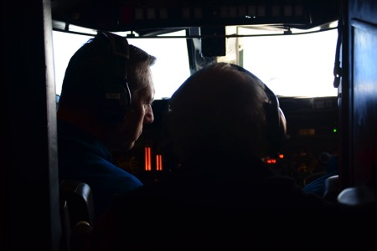
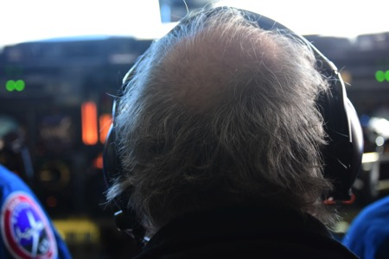
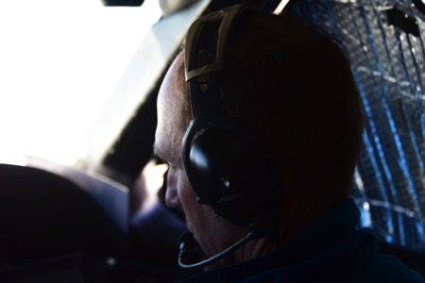
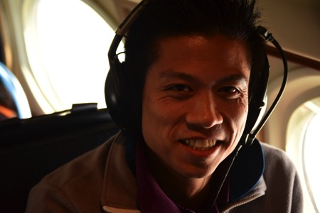
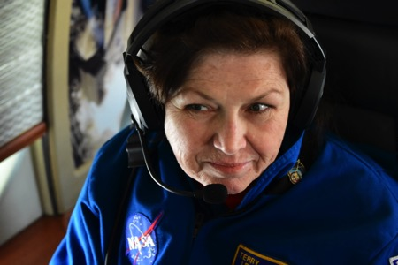
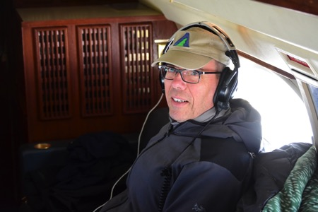
14 August 2017/DOY 226 SW Alaska – Yukon-Kuskokwim Delta
Stevens Village
Beaver
‘Picard’ in his customary seat watching over NASA 2 and the onboard crew

Slide 5
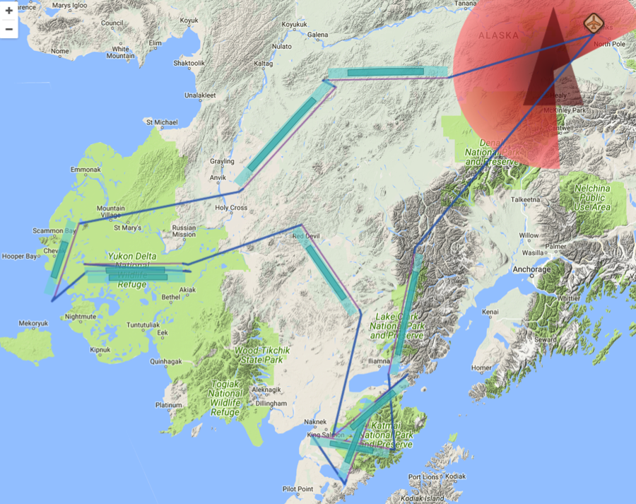
14 August 2017/DOY 226 SW Alaska – Yukon-Kuskokwim Delta
Report 17080: Fairbanks AK (PAFA) – Fairbanks AK (PAFA)
https://uavsar.jpl.nasa.gov/cgi-bin/report.pl?planID=PLAN_17080#flightPlan
As-flown Lines
Data Acquisitions:
Line 1, ID 19204: Lake Clark
Line 2, ID 28019: Katmai 1
Line 3, ID 02110: Katmai 2
Line 4, ID 23002: Katmai 3
Line 5, ID 32607: Snake River
Line 6, ID 27030: YK Delta 1
Line 7, ID 27031: YK Delta 2
Line 8, ID 01811: Chevak
Line 9, ID 04214: Innoko
Line 10, ID 08910: Poorman
Lines from Plan 1166_v01
Lines from Plan 1167_v01
15010
34505
28608
03107
16404
34407
20007
16404
34407
34407

Slide 6
14 August 2017/DOY 226 SW Alaska – Yukon-Kuskokwim Delta
P-band SAR Quick-Look products
Line 1, ID 19204: Lake Clark
Line 5, ID 32607: Snake River
Joanne Shimada, JPL
A
B
Notes:
Rugged vegetated terrain near Lake Clark and the SWAN validation sites
Source of the Snake River imaged

Slide 7
14 August 2017/DOY 226 SW Alaska – Yukon-Kuskokwim Delta
P-band SAR Quick-Look products
A. Line 2, ID 28019: Katmai 1
B. Line 3, ID 02110: Katmai 2
C. Line 4, ID 23002: Katmai 3
Joanne Shimada, JPL
A
B
C
Notes:
Bright vegetation images in the rugged terrain and wetlands surrounding Katmai National Park

Slide 8
14 August 2017/DOY 226 SW Alaska – Yukon-Kuskokwim Delta
P-band SAR Quick-Look products
A. Line 6, ID 27031: YK Delta 1
B. Line 7, ID 27030: YK Delta 2
Joanne Shimada, JPL
A
B
Notes:
Composite image of the YK Delta swaths over the Schaefer, Natali, and Frost ABoVE ground sites

Slide 9
14 August 2017/DOY 226 SW Alaska – Yukon-Kuskokwim Delta
P-band SAR Quick-Look products
A. Line 8, ID 01811: Chevak
B. Line 9, ID 04214: Innoko
C. Line 10, ID 08910: Poorman
Joanne Shimada, JPL
A
B
C
Notes:
Image recorded in swath parallel to the Bering Sea coast near Chevak AK. Note the very different light green signals from the wetland near the end of the swath
The lakes, rivers and wetlands of the Innoko NWR
Swath over tree ring ground sites near Poorman in Interior Alaska

Slide 10
Backup

Slide 11
14 August 2017/DOY 226 SW Alaska – Yukon-Kuskokwim Delta
This flown plan originated from this pre-plan:
PLAN_1166_v01, created Jul 13, 2017
This flown flight plan contains at least one flight line from the following flight plan(s):
PLAN_17055, flown May 27, 2017 PLAN_17054, flown May 26, 2017
PLAN_1167_v01, created Jul 13, 2017

